Slide 1
QA
НАЧАЛЬНЫЙ УРОВЕНЬ
ПРАКТИКА. ЗАНЯТИЕ #3

Slide 2
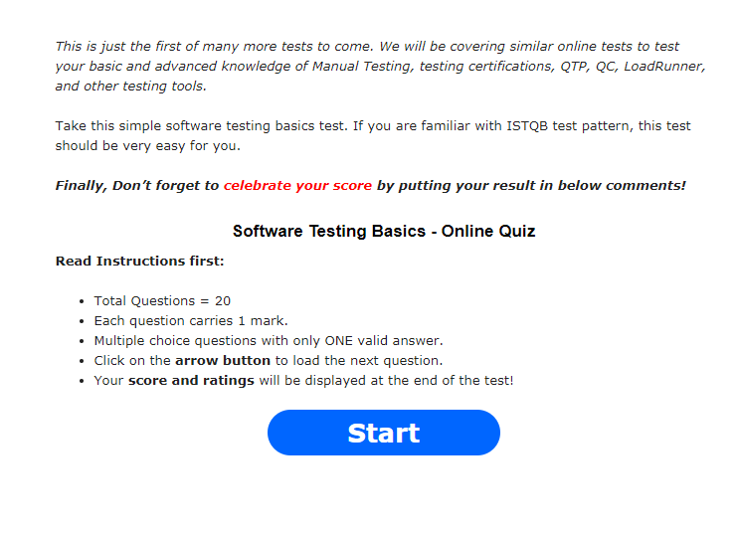
Software Testing Basics
http://www.softwaretestinghelp.com/software-testing-online-quiz/

Slide 3
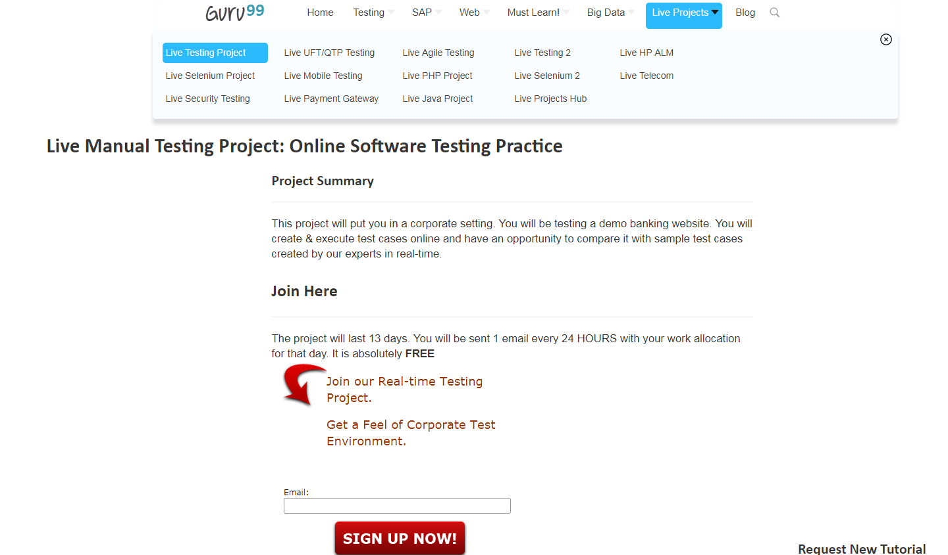
Testing Practice
https://www.guru99.com/live-testing-project.html

